Slide 1
Week 3 Update
By Randy & Dylan

Slide 2
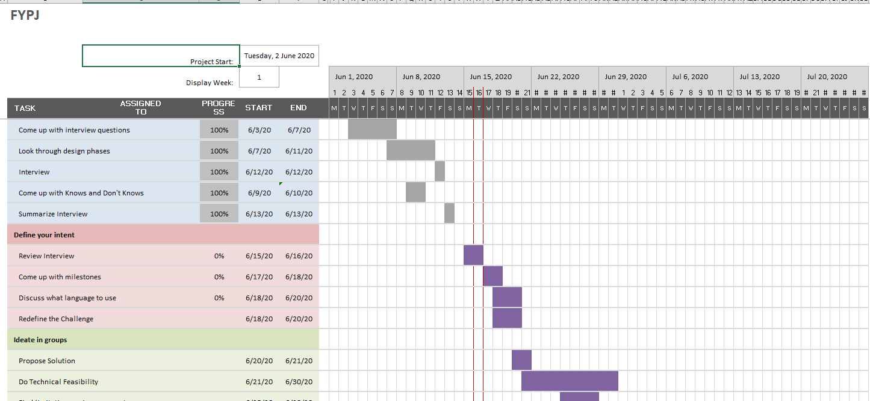
Gantt Chart

Slide 3
Summary for Interviews
Ms Kareen Koh
JunJie and Sherwin
Ms Loh Moi Yong

Slide 4
Ms Kareen Koh
In-charge of handling movie nights and entrepreneurship talk/networking talk
Entrepreneurship/Networking talk
No seating arrangement, first come first serve
Movie Nights
Start from middle to back seats
Filling up on the middle 6-8 seats, proceeding to the back row till all the middle seats are filled. Work on the seats left and right from the middle

Slide 5
Ms Kareen Koh
Alumni are involved as well for ushering and giving out tickets
Does not have any limitation/difficulties so far (have not encountered any)
Movie Theatre does include handicap seats
Does have conflicts
Customers not happy with their seats
Late customer found other people seating in their seats

Slide 6
Ms Kareen Koh
What she likes currently
Able to note in any seating arrangement with map
Able to indicate how many rows and column are in a cinema and block out seats
What she does not like currently
Payment using AXS have to be double check
Have to also check if they double paid

Slide 7
JunJie
In-charge of attendance, ushering, supervising and handling conflicts
Common conflict
Max is only 2 people where a lot of group came in more than 2

Slide 8
Sherwinn
In-charge of issuing tickets
Process
Signup through link
Scanning QR Code on phone
Issuing tickets manually
What he does not like
Ticket are not automatic, resulting in lots of manpower used and messy

Slide 9
Sherwinn
Conflicts
Most common conflicts would be people not liking their seats as they are first come first serve
What they would like to have in the app
Waiting list for extra people

Slide 10
Ms Loh Moi Yong
In-charge of color-coding, planning seats and printing out tickets
Preparation are done months beforehand
Her difficulty would be having to cut out the tickets
E-tickets would be the solution

Slide 11
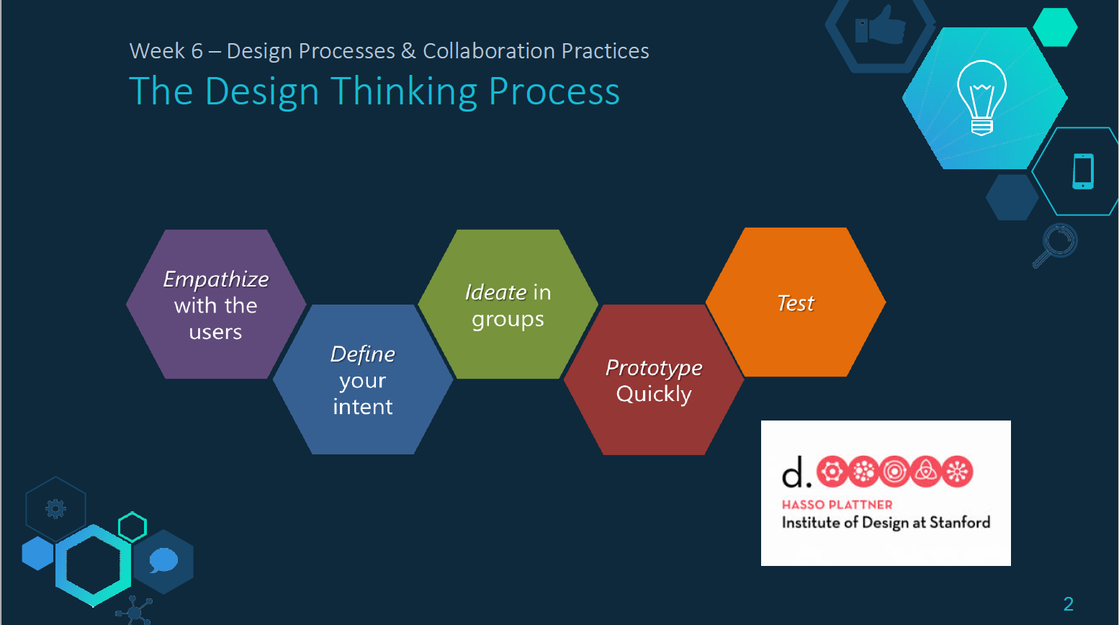
Design Thinking

Slide 12
Phase 1: Empathize with User
Knows
We know that the current system is tedious to use
We know that the system has to be able to seat according to the venue constraints
We know that the system has to be dynamic
We know that the elderly and handicapped require seats that are easy accessible
We know that tickets are issued manually which might be hard to keep track of
Don’t knows
We don’t know if a system like this would reduce conflicts between users
We don’t know if the system would be able to handle large venues
We don’t know if the system would be able to scale to the venue on the day
We don’t know if the venue would allow limitations such as the elderly or handicapped
We don’t know if

Slide 13
Phase 1: Empathize with User (User Persona 1)
Alex (Planner)
Not knowing the place of event well
Need to cut out tickets and manually check if there are no double prints
Alex is able to use our program to check event’s seating arrangement as well as make e-tickets for the event.

Slide 14
Phase 1: Empathize with User (User Persona 2)
(Usher)
Not being able to coordinate with the issuing
Need to manage conflicts between them and guests
Alex is able to use our program to manage the seats and to reduce conflicts as the seats would be pre-determined by a system

Slide 15
Phase 2: Define your intent
Our problem is that major events almost always takes up huge amount manpower and paper. There are also always errors involved in printing out tickets and conflicts to handle during the event as well.

Slide 16
Phase 3: Ideate
Our solution is to create a seamless platform that will help lessen the manpower involved in these major events. It is to also make the planning much smoother by entering a few variables in the platform to generate out the ticketing system.

Slide 17
Phase 3: Ideate (How might we)
How might we create a platform to improve on the planning of major events in school
How might we improve the ticketing system in place

